Slide 2
Institute for Democracy and Economic Analysis (IDEA) is an independent public policy think tank focusing on evidence-based analysis, evaluation and policy recommendations founded on facts, data and modern economic theory.
IDEA is a think-tank arm of CERGE-EI, a collaborative venture of Charles University and the Academy of Sciences of the Czech Republic focusing on economic research and graduate education. IDEA was founded and has been directed by Professor Jan Švejnar.

Slide 3
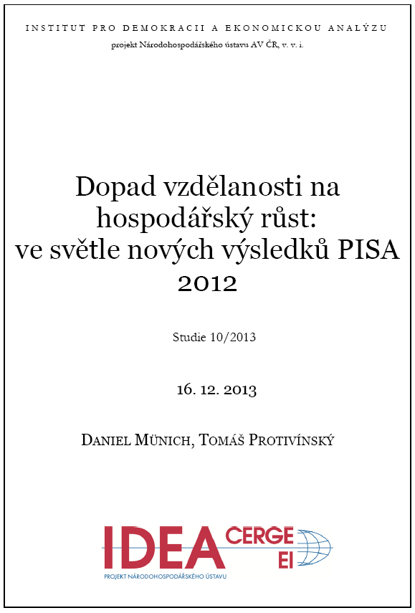
17.5%

Slide 4
Few reminders on the Czech situation!

Slide 5
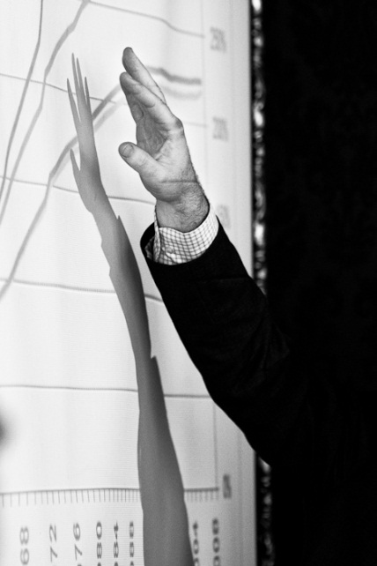
Decentralization and the quality of teaching: Accompanying evidence from the Czech Republic
DANIEL MÜNICH

Slide 7
Teacher’s salaries at the lower secondary level relative to other tertiary educated workers [>15 years of experience] Source: OECD (2010), Education at a Glance 2010: OECD indicators.

Slide 8
Share of tertiary educated workers (non-teachers) with salaries below average salaries of primary school teachers (by age)
Zdroj: own computations based on ISPV

Slide 9
Thank you!

